Slide 1

Dictionary and its 5 operations
Name: Jignesh Raheja
Roll no.: CS3-38
PRN: 202401040154

Slide 2

Dictionary
A dictionary in Python is an unordered collection of key-value pairs.
Defined using curly braces {} with keys and values separated by colons.
Keys must be unique and immutable (strings, numbers, or tuples).
Values can be of any data type.

Slide 3

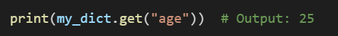
Creating and Accessing Dictionary Elements
Dictionaries can be created using {} or the dict() constructor.
Access values using keys:
Use .get() to access values safely:

Slide 4

Five key operations OF Dictionary:
Adding/Updating elements
Removing elements
Iterating through a dictionary
Checking key existence
Merging dictionaries

Slide 5
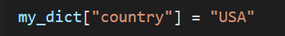


Operation 1 - Adding and Updating Elements
Add new key-value pairs:
Update existing values:
Output: {'name': 'Alice', 'age': 25, 'city': 'New York', 'country': 'USA'}
Output: {'name': 'Alice', 'age': 26, 'city': 'New York', 'country': 'USA'}

Slide 6
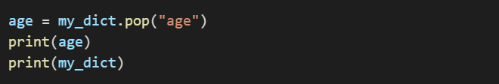
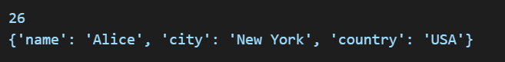
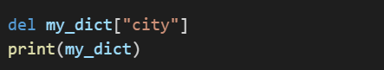

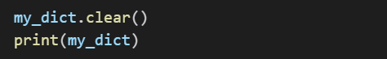
Operation 2 - Removing Elements
Use pop() to remove a key and return its value:
Output:
Use del to delete a key:
Output: {'name': 'Alice', 'country': 'USA’}
Use clear() to remove all elements:
Output: {}

Slide 7

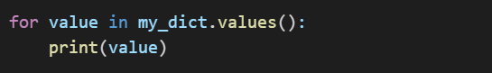


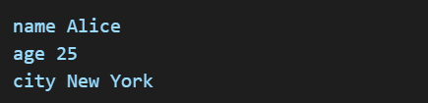
Operation 3 - Iterating Through a Dictionary
Loop through keys:
Loop through values:
Loop through key-value pairs:
Output:

Slide 8
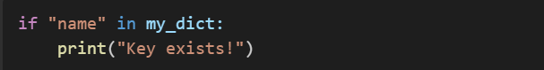
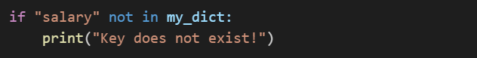

Operation 4 - Checking Existence of a Key
Use in keyword:
Output: Key exists!
Returns True if key exists, otherwise False.
Another example:
Output: Key does not exist!

Slide 9
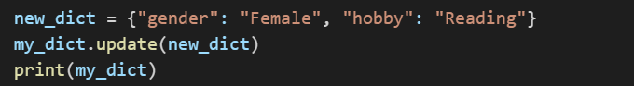

Operation 5 - Merging Dictionaries
Use update() to merge dictionaries:
Output: {'name': 'Alice', 'age': 25, 'city': 'New York', 'gender': 'Female', 'hobby': 'Reading'}

Slide 10

summary
Python dictionaries store data in key-value pairs.
Five key operations:
1. Adding/Updating elements
2. Removing elements
3. Iterating through a dictionary
4. Checking key existence
5. Merging dictionaries

Slide 11

THANK YOU!☺

